Slide 1
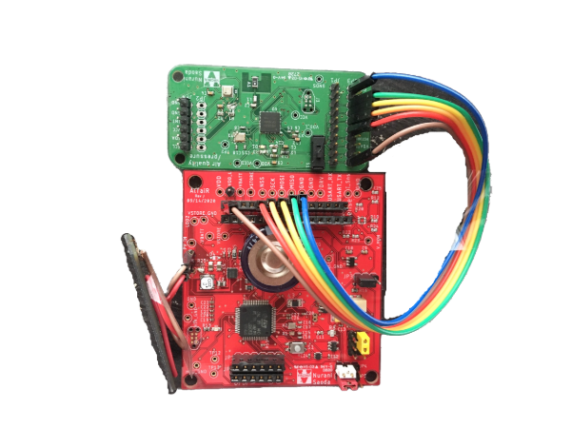
An Energy Supervisor Architecture for Energy-harvesting Applications
Nurani Saoda, Wenpeng Wang, Md Fazlay Rabbi Masum Billah, Bradford Campbell
University of Virginia
IPSN’22, May 4-6, 2022

Slide 2
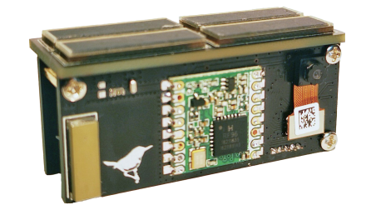
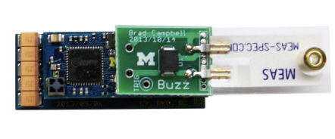
The battery-less vision of IoT is intriguing
Occupancy detection
Battery-less energy metering
Solar harvesting smart blinds
Light harvester panel
Thermal harvester
Battery-less AR specs
Home security
Battery-less contact sensor
Battery-less wearables
Thermal harvesting textile
Built-in kinetic harvester panel for activity monitoring
Kinetic harvesting smart shoe
Notes:
Future of Internet of things-> sensors would be green, perpetual, low-maintenance, deploy-and-forget
Make the figure clear.

Slide 3
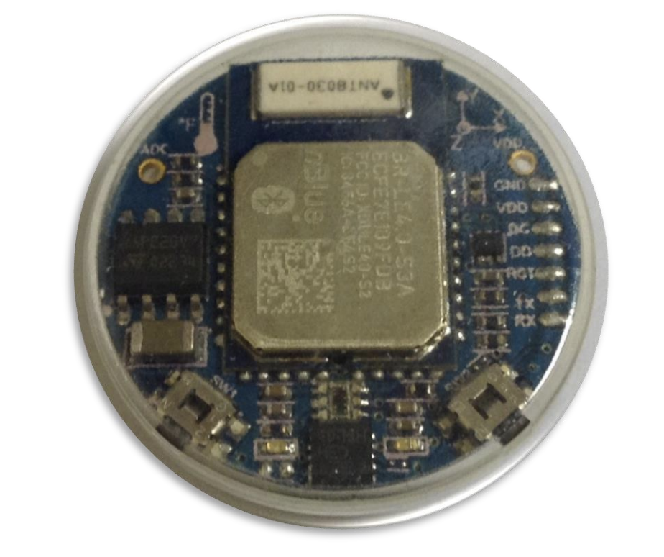
What are the challenges of making battery-powered sensors battery-less?
Available energy varies depending on time, space, and the source of energy
The power supply hardware and energy-management technique is co-designed according to application needs.
Notes:
Add picture to remove the battery and add energy-harvesting
No guaranteed minimum energy at runtime
Loosing the reliability and simplicity of battery-powered applications design.
Making the power supply hardware and energy-management technique general for different application needs is difficult
Battery image, blurry image

Slide 4
Where does the existing energy-harvesting design approach fall short of?
1. Limited power supply hardware functionality
V_{cap}
V_{3.3V}
P_{Good}
Bat_chg
PMIC
Device
The device operation is controlled by fixed hardware, but the device has limited control over the power supply
Notes:
The device operation is controlled by fixed hardware, but the device has limited control over the power supply
Traditional energy-harvesting battery-less systems have limited control/optimization capability in the energy-harvesting power supply hardware and the energy management software is entangled with application logic.
Hardware- limited control/optimization capability
Software – not efficient, not scalable, fixed
We argue that to make energy-harvesting general across different applications and different energy-harvesting scenarios the device might experience. The power supply supply hardware needs to be programmable, the software needs to be modular, decoupled, independent from the application code.
Animation in the slide

Slide 5
Where does the existing design approach fall short of?
main {
if (energy>a) {
sense ();
}
if (energy>b) {
transmit ();
}
…
}
2. Lack of proper software interface
Energy management tasks are tightly-coupled with application specific tasks
Notes:
Traditional energy-harvesting battery-less systems have limited control/optimization capability in the energy-harvesting power supply hardware and the energy management software is entangled with application logic.
Hardware- limited control/optimization capability
Software – not efficient, not scalable, fixed
We argue that to make energy-harvesting general across different applications and different energy-harvesting scenarios the device might experience. The power supply supply hardware needs to be programmable, the software needs to be modular, decoupled, independent from the application code.
code formatting and indentation

Slide 6
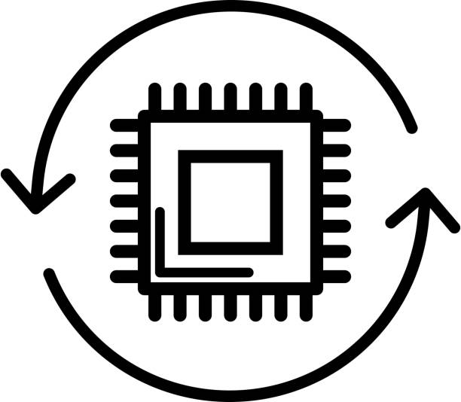
This coupling restricts development in multiple ways..
Burdens application developer
Independent power supply and application design is not viable
Difficult to adapt to new applications
Fixed design time dependency leads to suboptimal performance
Impedes independent development
Difficult to adapt to new applications
Burdens developer
We argue that battery-less designs require a well-balance between providing enough abstraction as well as control into the underlying energy optimization mechanism.
Notes:
Fixed design time dependency-> what does that denote-> static dependency between the energy and application
Add animations?

Slide 7
We propose Altair, a novel energy supervisor architecture for energy-harvesting applications that decouples energy related decisions from an embedded application’s task execution.
Notes:
Hardware-software interface

Slide 8
Application Code
Application Code
Energy-management
main {
if (energy>a) {
sense ();
}
if (energy>b) {
transmit ();
}
}
main {
r =energy_manage()
sense (r)
transmit (r)
}
Energy-management
energy_manage { return duty_cycle
}
Hardware
Hardware
Energy-harvesting Power Supply
Hardware
MCU
MCU
Energy-harvesting Power Supply
App Peripherals
App Peripherals
Traditional implementation
Altair
Energy specific decisions are performed separate from the application
Notes:
Animation one by one

Slide 9
Altair System Design
The Energy Supervisor
Power
Main Application
Energy-harvesting Power Supply Hardware
Energy API
Low-level drivers
Energy API
Control
Data
Energy-Application Interface
The supervisor interacts with low-level hardware
The main Application uses specific APIs at runtime to ask energy-related parameters
Notes:
API and functions.
the tradition system black diagram
Interface highlight removed
the left arrow

Slide 10
Altair achieves several benefits:
General, reusable application power supply interface
Independent and parallel development
Easily translates to new applications
Notes:
RETROFITTTING********
Changes in application logic does not require re-evaluating the energy code.
In three, talk about retrofitting

Slide 11
Altair design trade-offs
Software version
Hardware version
Energy Supervisor
Application code
Energy Supervisor
Application code
Software
Hardware
MCU
MCU
MCU
Peripherals
Power supply
Peripherals
- Overburdens application processor
+ Minimal resource conflict
+ Decoupling in power domain
+ Re-usable and general interface
We implement the energy supervisor in a low power microcontroller.
Notes:
Trade-off with the software systems and what are alternatives and how we got here
Number 1-> memory, clock isolation
Number 3-> different tools can be used for both sides-> MCUs could be different
Diagram showing the software and hardware versions
Add the energy supervisor , and show an example of how this wokrs

Slide 12
Features of the Energy Supervisor
The Energy Supervisor
{allowed duty-cycles, list of tasks, optimization algorithm}
Main Application
Write
Read
Energy API
Power supply drivers
Energy API
{Optimal duty cycles, power modes, energy statistics}
Energy-Application Interface
Interacts with the power supply hardware and the load to monitor energy
Implements an online energy management algorithm to achieve energy-neutrality

Slide 13
Energy-Application Interface: Hardware interface
3.3V
The Energy Supervisor
1.8V
Main Application
Voltage
V_{dutycycled}
Energy API
Energy API
Control
Data (SPI)
Debug (UART)
Hardware Interface
Notes:
The main application invokes the supervisor to call functions-> by sending a write request.
It makes a call into the supervisor by sending a read request.

Slide 14
Reinforcement learning-based energy optimization
RL agent
(+)ve ∝ stored energy and sampling frequency
(-)ve if capacitor depleted critically
Actions
Reward
Beaconing rate of the sensor [1,2,3,4,5] s
States
Stored energy
Avg Incoming energy
Avg load energy consumption
Power supply
Sensor
Environment
Notes:
RL agent stuff
states bullet point

Slide 15

Altair Platform Implementation
App Module
Power supply Module
Interface
The platform allows integration of different external sensors
Notes:
ideally

Slide 16
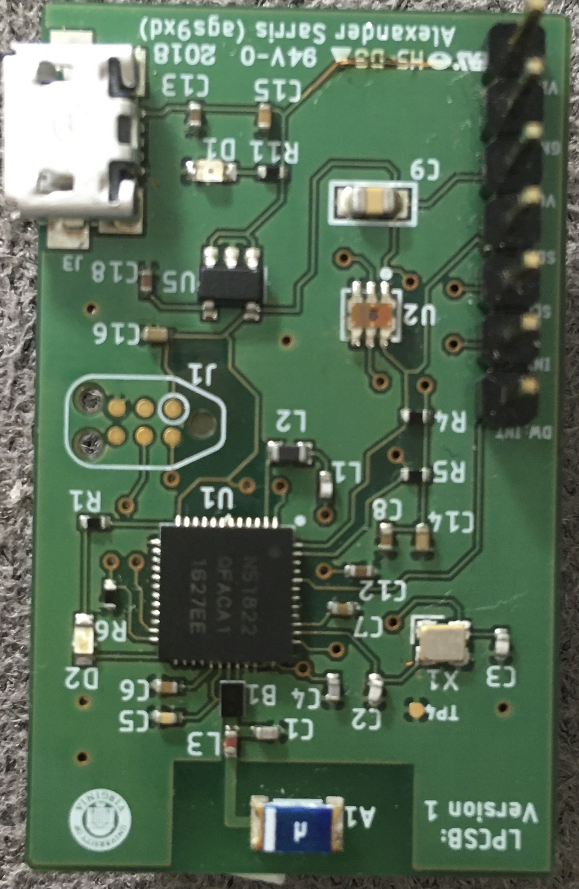
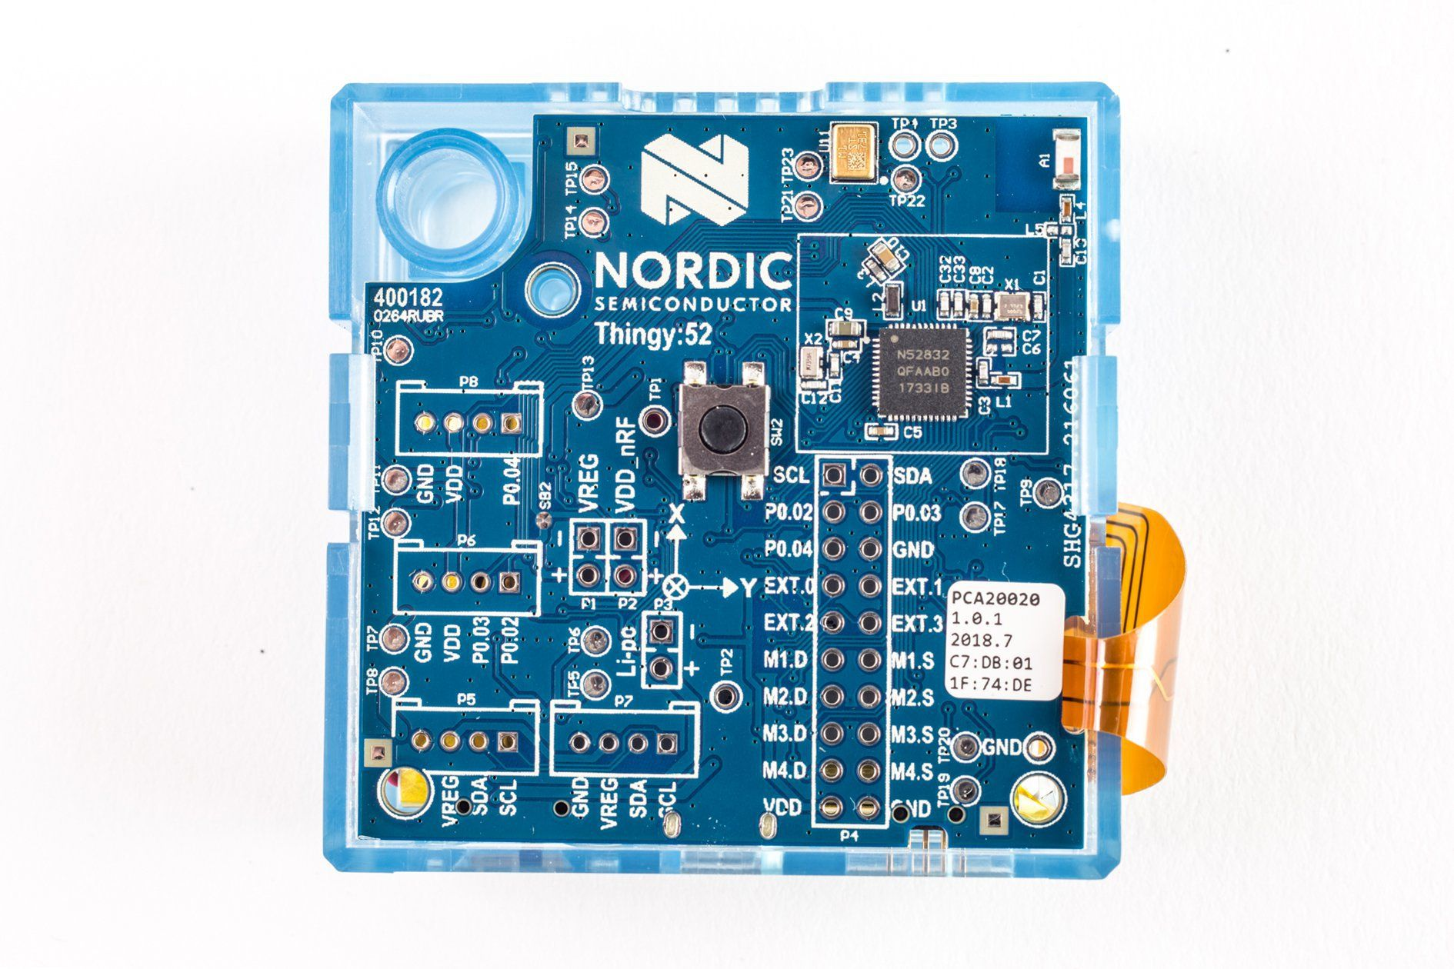
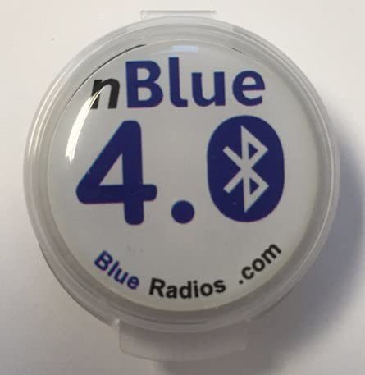
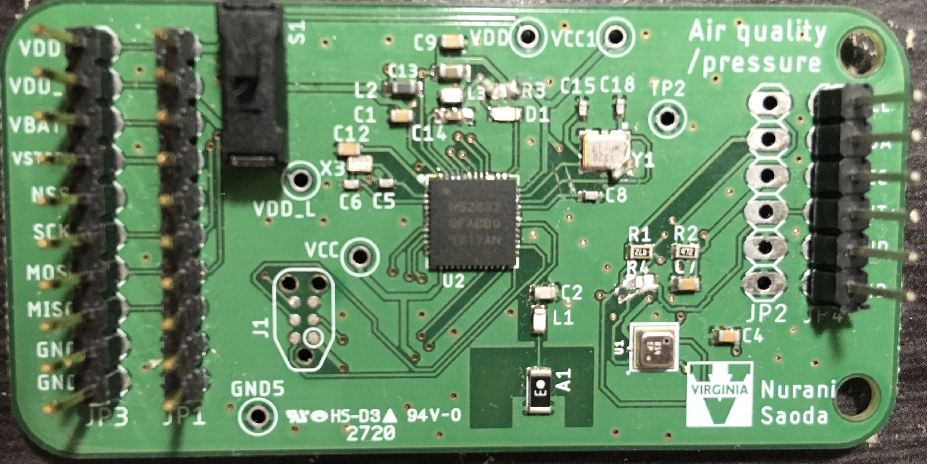
We integrate six IoT devices with Altair
Flexible
Battery
USB
Intermittent solar
Battery
Battery
Pascal
BLEES
LPCSB
Herald
Thingy:52
SensorBug
Decreasing flexibility
Six devices with varying levels of hardware and software flexibility
Demonstrate the generality and re-usability of the platform
Implement three different energy optimization technique
Notes:
scope this down
key points
the extreme point of the diagram to the next level
Table to show the difference between the platforms
custom and modifiable meaning and table and remove the labels. other specificaitons

Slide 17
We compare the performance of different duty-cycling techniques
Three energy-management technique:
Altair- Online reinforcement learning based
Altair-Max- Selects the maximum sampling rate
Altair-Min- Selects the minimum sampling rate
Default- Flexible
Default- Battery
Default- Battery
Pascal
BLEES
Thingy:52
95th percentile interval is within 10x of the continuously powered one
Notes:
Too many graphs in the slide-> adding the key findings to the slide
Min and max discuss->
not talk about the figure
The takeaway message ->

Slide 18
How does the supervisor perform in terms of data generation and active time?
Up to 75% of the continuous sensing
Notes:
Data yield is always higher than Altair-Min and in the case of active time, altair outperforms the other variants
Active time graph and what that means
add key takeaway on the plot 17

Slide 19
Concluding remarks
Step towards a general interface between energy-harvesting power supplies and application design
Enhances the energy-harvesting power supply with dedicated hardware and modular software
Could enable retrofitting existing battery-powered devices.
Notes:
third bullet ambigious claim. not too strong

Slide 20
Questions?
Nurani Saoda
saoda@virginia.edu

Slide 22
Energy Supervisor
Performs energy management by monitoring and predicting system energy
Interacts with the power supply hardware and the load to monitor energy
Implements dynamic energy management algorithm and the API functions.
Implementation:
RL-based energy-management for online energy optimization

Slide 23
Altair design trade-offs
Software version
Hardware version
Application
Energy Supervisor
Energy Supervisor
Application code
main {
r =energy_manage()
sense (r)
transmit (r)
}
main {
energy_manage { return duty_cycle
}
}
main {
r =energy_manage()
sense (r)
transmit (r)
}
energy_manage { return duty_cycle
}
Software
Hardware
MCU
MCU
MCU
Peripherals
Power supply
Peripherals
- Overburdens application processor
+ Minimal resource conflict
+ Decoupling in power domain
+ Re-usable and general interface
We implement the energy supervisor in a low power microcontroller.
Notes:
Trade-off with the software systems and what are alternatives and how we got here
Number 1-> memory, clock isolation
Number 3-> different tools can be used for both sides-> MCUs could be different
Diagram showing the software and hardware versions
Add the energy supervisor , and show an example of how this wokrs

Slide 24
to receive optimal duty-cycle of operation over a time period
receives any hard requirements from the application
Energy-Application Interface: Energy API
Altair implements a set of energy API on top of a general hardware interface
status to ask for capacitor energy level
Energy Supervisor | Main Application
c_param_t get_critical_parameters() | dc_t get_optimal_dutycycle()
list_param_t get_app_list() | double get_current_energy_status()
mode_param_t get_power_modes() | int get_update_period()
 | model_array_t get_energy_model()
List of Energy API
receives a list of running tasks
Notes:
plain text of the software API implementation
not the technical details
intuition of how we got there
get_critical_parameters returns an array of permitted duty-cycles of the running application, according to which the energy supervisor optimizes for long term energy neutrality, and which energy optimization algorithm from the supported ones to use.
Energy-atomic operations are categorized into sampling a sensor, computing and analysing the sampled data, transmitting data, or receiving data
The application specifies the required operating power modes using get_power_modes.
get rid of the list of APIs.
and just explain

Slide 25
Example control flow diagram between the supervisor and application
Energy supervisor code
App code
int main (){
…..
wait_for_cmd_from_app (); get_critical_parameters();
get_ app_list();
get_ power_modes();
…..
}
int main (){
…..
configure_supervisor();
….
get_current_energy_status();
set_timer = get_update_period();
// once set_timer expires
get_optimal_duty_cycle();
…..
}
xx
Notes:
remove this one

Slide 26
Preliminary Results
Energy-management Domain
Notes:
simplify the diagrams

